Slide 1
Week 11a: Problem solving 101

Slide 2


Slide 3
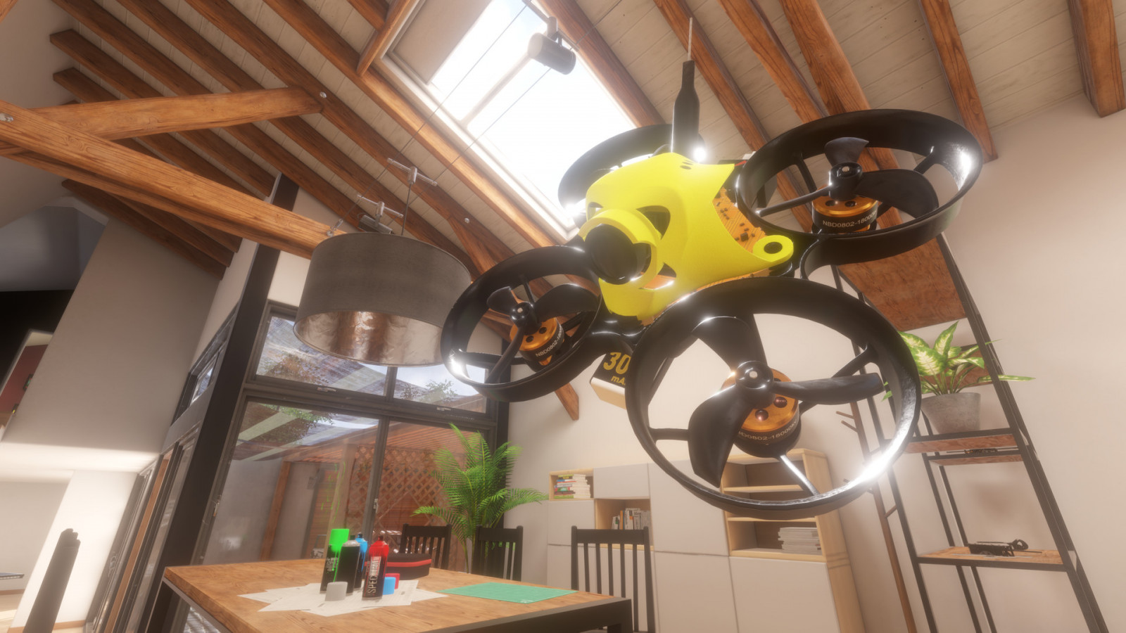
Last class
Kasper from Lugus came for a talk
Want to say two things about it

Slide 4
Internship
He was being serious
You can do that internship there if you don’t want to go into games
3D is a valuable skill

Slide 5
“It’s all just floats”
Kasper said it. What did he mean by it?
I said it a while ago. What did I mean by it?

Slide 6
It’s all just floats
Don’t be confused by Unity’s editor
This is low level coding
Normals, Vectors, Colors, Positions are all just Vector3’s
Textures and meshes can have all kinds of data
They don’t have type safety

Slide 7
Reasoning
An engine like unity will cover 80% of your use case
Needs the flexibility for the rest of the 20%
And we can’t lose performance for performance
Consequence: you need to understand 100% of it

Slide 8
Questions?

Slide 9
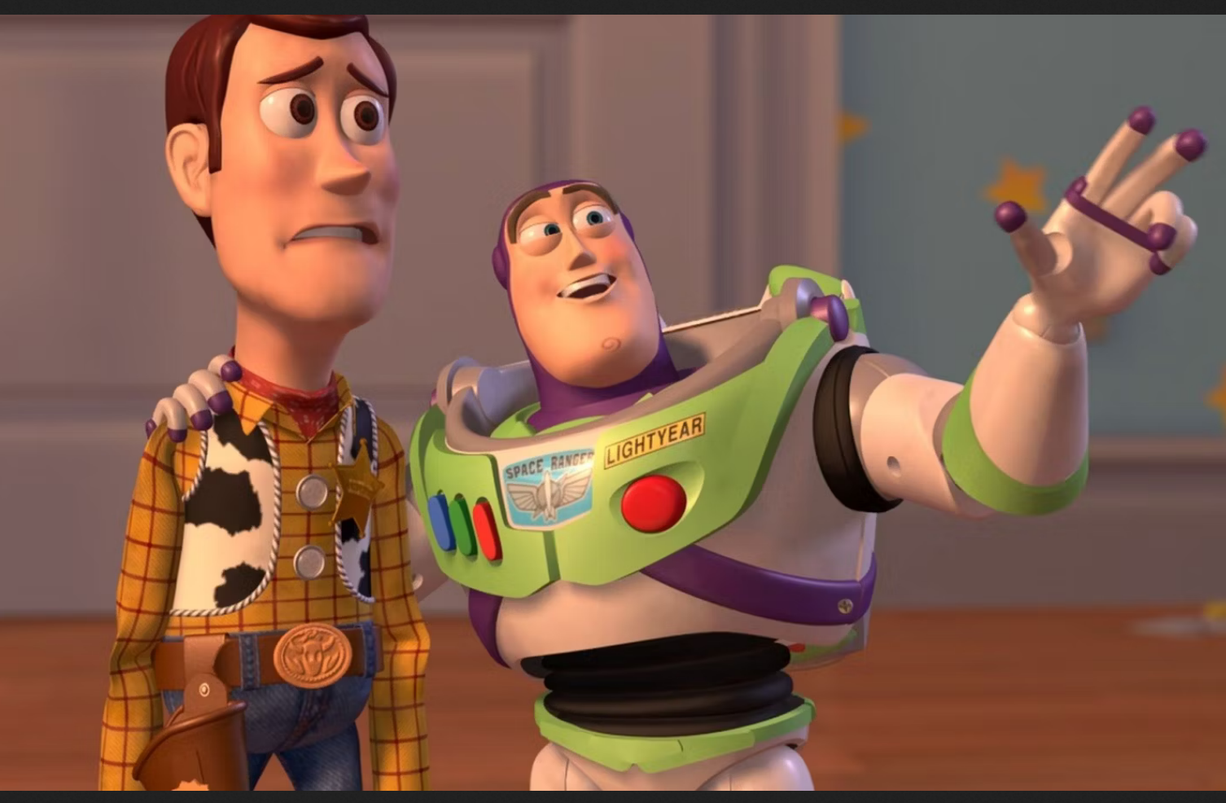
Course schedule
 | Monday | Thursday
Week 1 : 12/02 | Introduction | C#/Unity Lab
Week 2 : 19/02 | 3D reasoning | 3D Lab
Week 3 : 26/02 | Basic Pipeline | Lab
Week 4 : 04/03 | Textures | Normal maps Labs
Week 5 : 11/03 | Post processing | Camera’s Light
Week 6 : 18/03 | Materials | Aliasing Materials Lab
Week 7 : 25/03 | Procedural generation Theory | Procedural generation Practice
Week 8 : 15/04 | Advanced pipeline | Cancelled
Week 9 : 22/04 | Lab 07 explanation | Project explanation
Week 10 : 29/04 | Project explanation 2 | Guest Lecture Project Labs
Week 11 : | Problem solving 101 | Holiday ☹

Slide 10
This class
→ Also last class ☹ ←
Submission & Exam
Ghost writer
Console logging
Debug drawing

Slide 11
Also last class ☹
“Ne dikke merci”
A fat French thank you
Has been a painful at times as it was the first time
I see you’re getting it \o/

Slide 12
This class
Also last class ☹
→ Submission & Exam ←
Ghost writer
Console logging
Debug drawing

Slide 13
Submission
I take the last commit before the deadline
Make sure your project works by doing a “sanity check”
Clone your repo to a separate directory
Open that clean directory in Unity and check your project
Do this! I only grade what I get from your repo
Very little effort but a lot safer

Slide 14
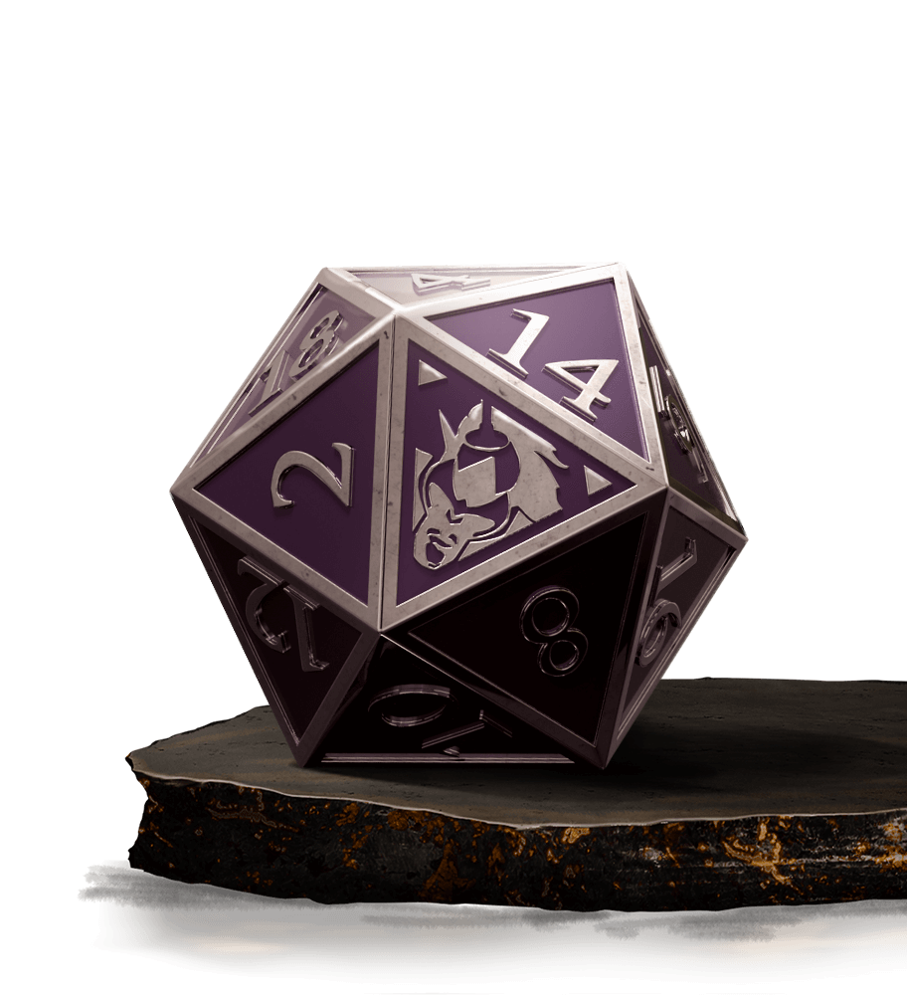
Exam
Will announce and post a link to claim your 20min timeslot
Arrive 20 minutes before
I’ve looked at your code before
You show your project on your machine
We look at some code, on my machine
I ask you questions about the code
“What does this line do?” “Why are you using a dot product here?”
If you need a minute, ask for a minute
Will upload a multiple-choice exercize to drill the fundamentals
Be confident

Slide 15
This class
Also last class ☹
Submission & Exam
→ Ghost writer ←
Console logging
Debug drawing

Slide 16
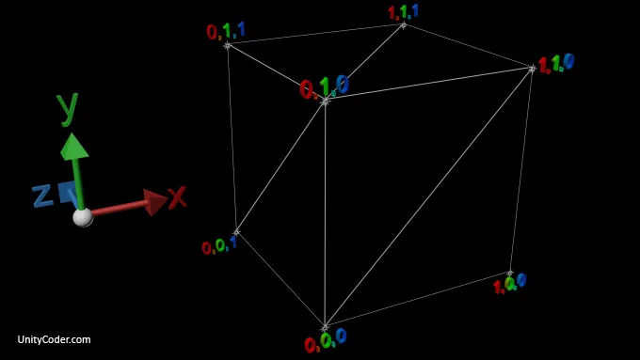
One of the first steps is to make a box
Vertices
Indices

Slide 17
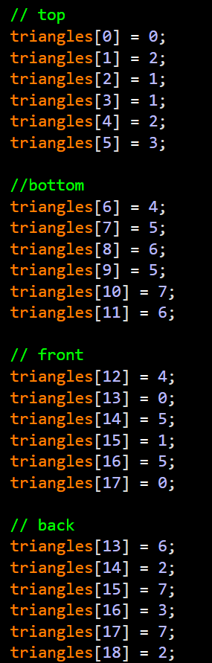
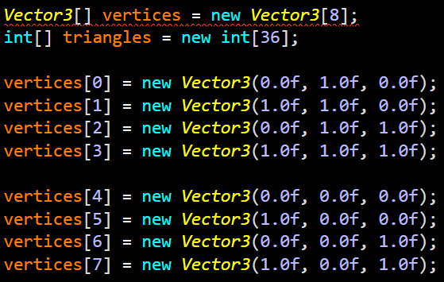
First attempt

Slide 18
Does anyone see a problem?

Slide 19
Problems
Error prone
Hard to visualize (is there a trick?)
Slow
Is there an easier way?

Slide 20
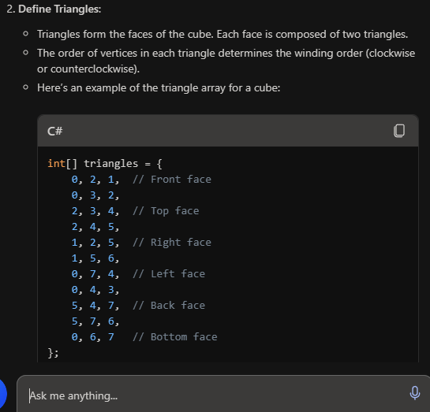
Ghost writer (ChatGPT)

Slide 21
Does it look good?

Slide 22
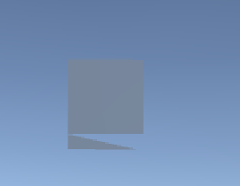
Result
Any problems?

Slide 23
Do you see the problem?

Slide 24
It’s right here

Slide 25
How you could have known : symmetry
Code that looks “wrong” has a high chance of being wrong
Usually, thing come in 3’s or a multiple of 2’s
This is how I find code to talk about
Reminder for self : look at vertices / indices

Slide 26
Conclusion
ChatGPT is pretty dumb
ChatGPT can save me time
If I already know what it’s trying to do
Do you agree?

Slide 27
This class
Also last class ☹
Submission & Exam
Ghost writer
→ Console logging ←
Debug drawing

Slide 28
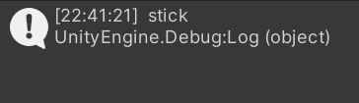
Console logging
Debug.Log is the same as other language’s print
Interface is pretty meh :/

Slide 29
Logging logs to a file
https://docs.unity3d.com/Manual/LogFiles.html
Allows you to use your usual text editor
Why is this better?

Slide 30
Problem : I think I generated too much dirt
Compared to stone and bedrock
How do I know for sure?

Slide 31
Log and check
Log “Generating block (16, 101, 8) in chunk (3,4) : BlockType.Dirt”
Can Ctrl+F “Generating block .+ Blocktype.Dirt” : 5194 occurrences
Can Ctrl+F “Generating block .+ Blocktype.Stone” : 12048 occurrences
Low effort
Uses tools you already know
Can diff a file against a known working version
Logging is good, because you implement it once, and you can always count on it
Any disadvantages?

Slide 32
This class
Also last class ☹
Submission & Exam
Ghost writer
Console logging
→ Debug drawing ←

Slide 33
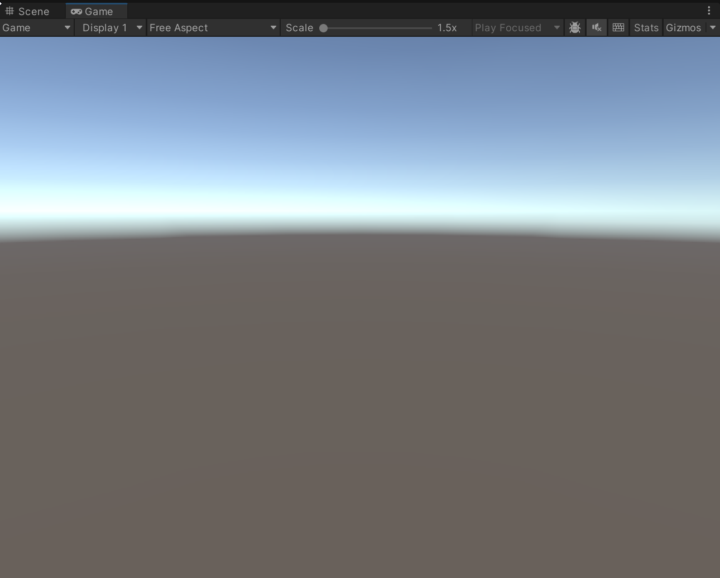
The most annoying problem in graphics
What’s the problem?

Slide 34
The most annoying error
My chunk is not showing up
What can be the reason?

Slide 35
Recap : debugging steps
Observe the problem (gather data)
Form a hypothesis (reasons it happens)
Check hypothesis
Create a fix
Check the fix

Slide 36
The most annoying error
My chunk is not showing up
What can be the reason?

Slide 37
Recap: basic debugging steps
My chunk is not showing up
What can be the reason?

Slide 38
Reasons for an empty screen
I opened the wrong repo
I opened the wrong scene
There is nothing in the scene
Object are scaled by (0,0,0)
Index buffers are wrong
Vertex buffers are wrong
Camera is looking away
Camera’s fov is 0.0
Objects are completely transparent
Shader is broken
Tons more…

Slide 39
Context: I was refactoring
Moved everything (terrain generation, mesh generation) into separate functions
Context is important, bugs are 90% in what you just changed
In a team: check source control log
This is (also) why you write good commit messages

Slide 40
What’s the next step?

Slide 41
Wireframe
Quick and easy
Nothing shows up
What have we learned?

Slide 42
Debug Drawing
https://docs.unity3d.com/ScriptReference/Debug.html
https://docs.unity3d.com/ScriptReference/Gizmos.html

Slide 43
Question: is the chunk wrong? Or the mesh?
Can we answer this by drawing a shape?

Slide 44
Draw a box around the chunk
If we see it, the mesh is wrong
If we don’t, something else (eg chunk generation) is wrong

Slide 45
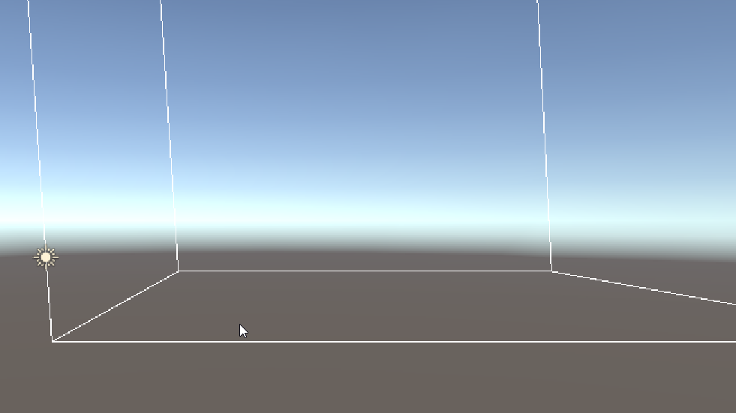
We can see the box, in the right place

Slide 46
What can we eliminate?

Slide 47
Solution
I skipped the entire mesh generation
Debugger could have been faster to find it
I now have my chunk visualization for the future

Slide 48
Conclusion
Debug drawing can make things obvious staring at numbers doesn’t
Is an investment
Don’t lose too much time using it

Slide 49
!!! Warning !!!
Never use Debug (or Gizmo) for actual functionality
This should never be shipped
It also doesn’t count for your grade

Slide 50

Next class

